Slide 1
For Pete’s Sake Games
Presents

Slide 2
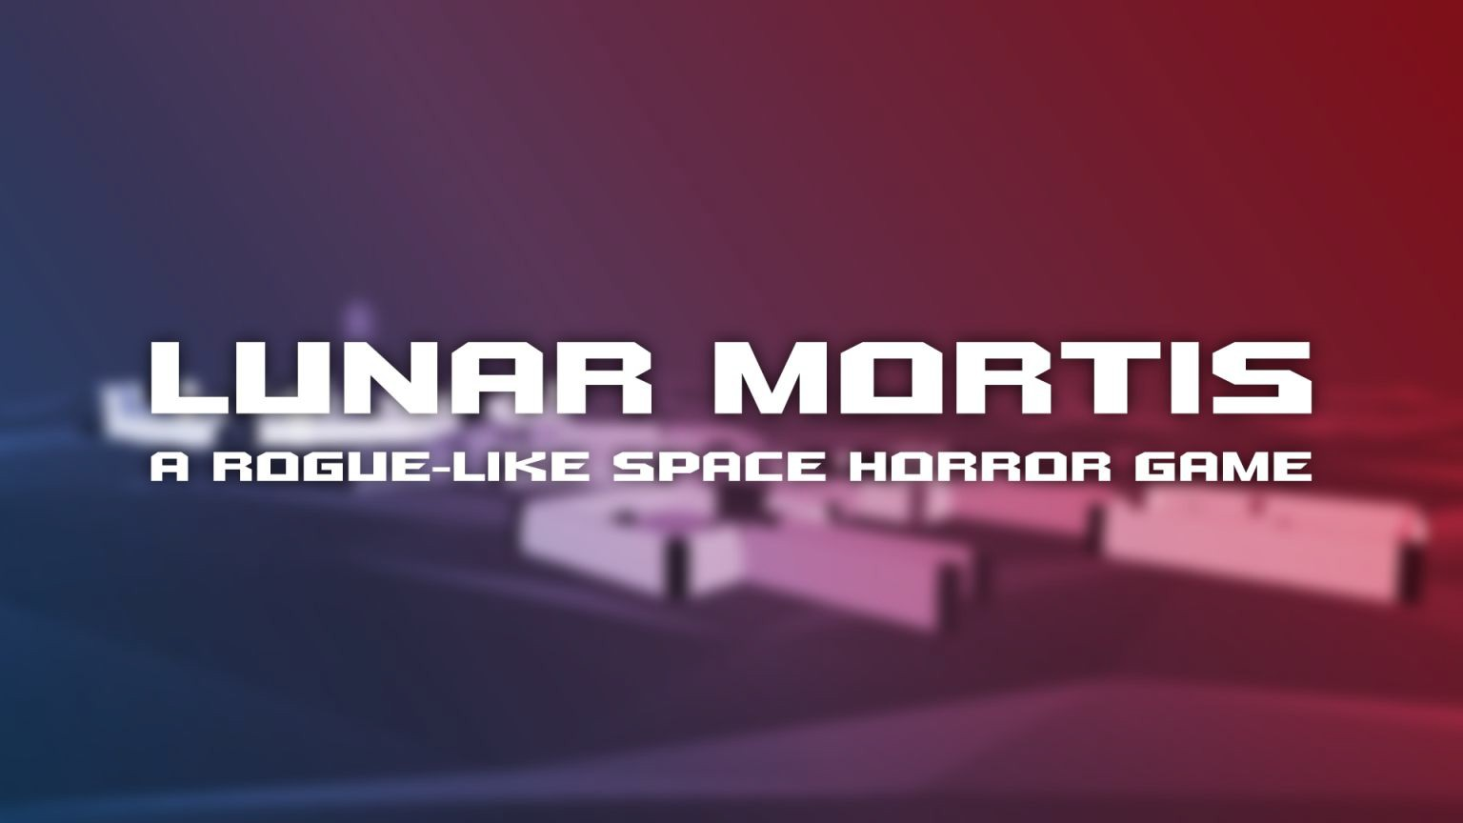

Slide 3

Story
The year is 2130, humanity has ventured out into the far reaches of the solar system in search for resources for our dying home planet.
The base on Titan, responsible for terraforming the moon, has switched operations to harvesting resources.

Slide 4

You and your team are excavating these resources from Titan. Speciﬁcally compact ice to supply the base with water to maintain life and power.

Slide 5

Little did the inhabitants know, harvesting this compact ice has awoken a hivemind virus which has been laying dormant for generations.

Slide 6

This ice gets melted down and sent around the moon base, hydrating the plants, supplying people with water and being stored for later use.

Slide 7

A week goes by, and people start noticing strange things happening throughout the space station.
It started with some individuals having increasing headaches, others start to lose coordination.
Gradually, the virus starts taking over.

Slide 8

The virus examines the minds of its new inhabitants, searching for suitable candidates.
During its time within the mind of the humans, it learns of their home planet and forms a desire to infect Earth.
The virus has chosen you as the courier, twisting your reality and bending you to its will.

Slide 9
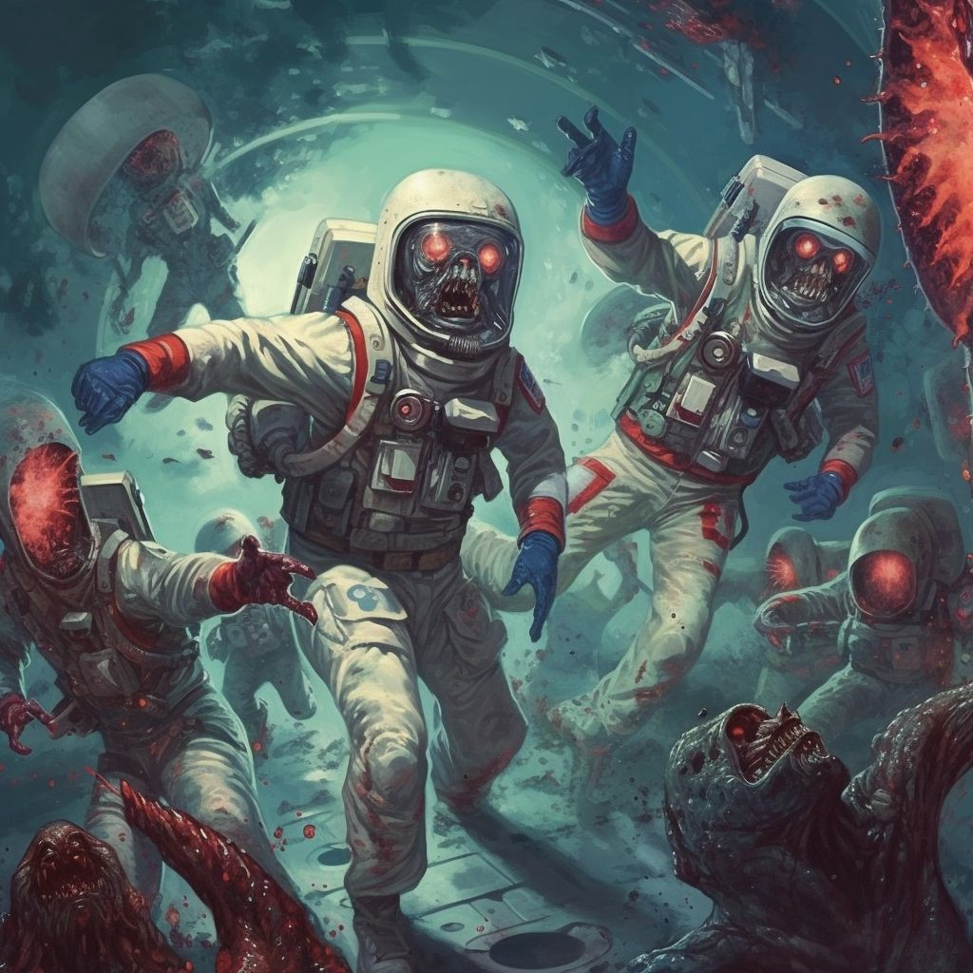
As for the rest of the crew, the virus deems them unworthy and discards them.
Soon enough, the bodies of the discarded rise up. Mindlessly and violently, they swarm the base.

Slide 10
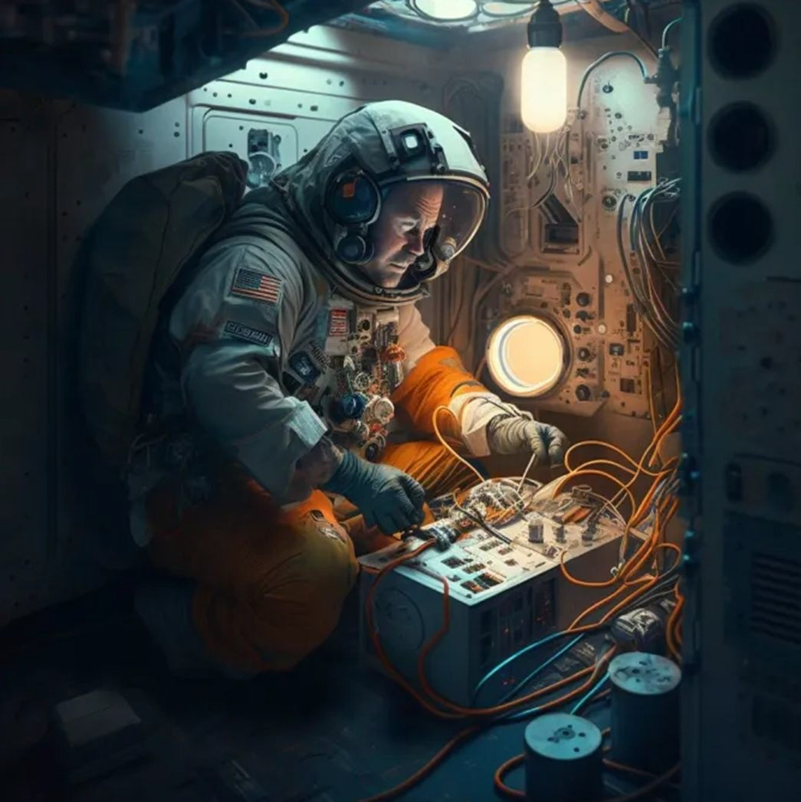
Due to the hivemind having a grasp over your perception of reality, the urge to return back to Earth strengthens. You will need to do whatever it takes to return home.

Slide 11
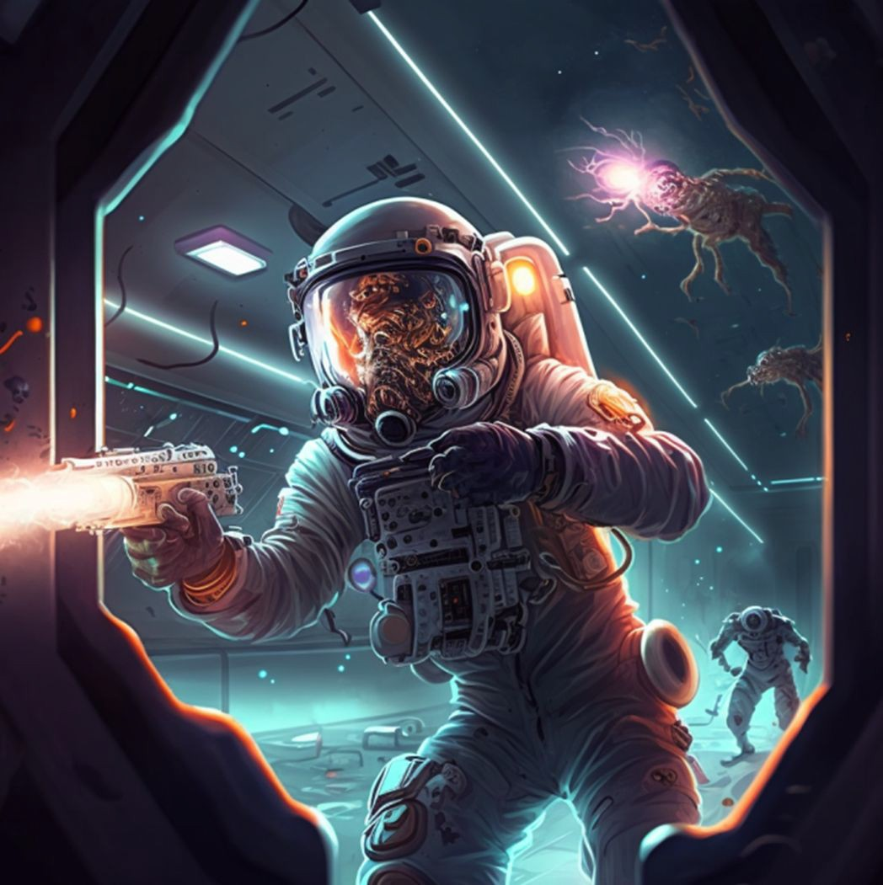
Once you locate the ship at the centre of the base, you must prepare the ship for take oﬀ, as well as ﬁghting for your life against all your ex colleagues and friends.

Slide 12
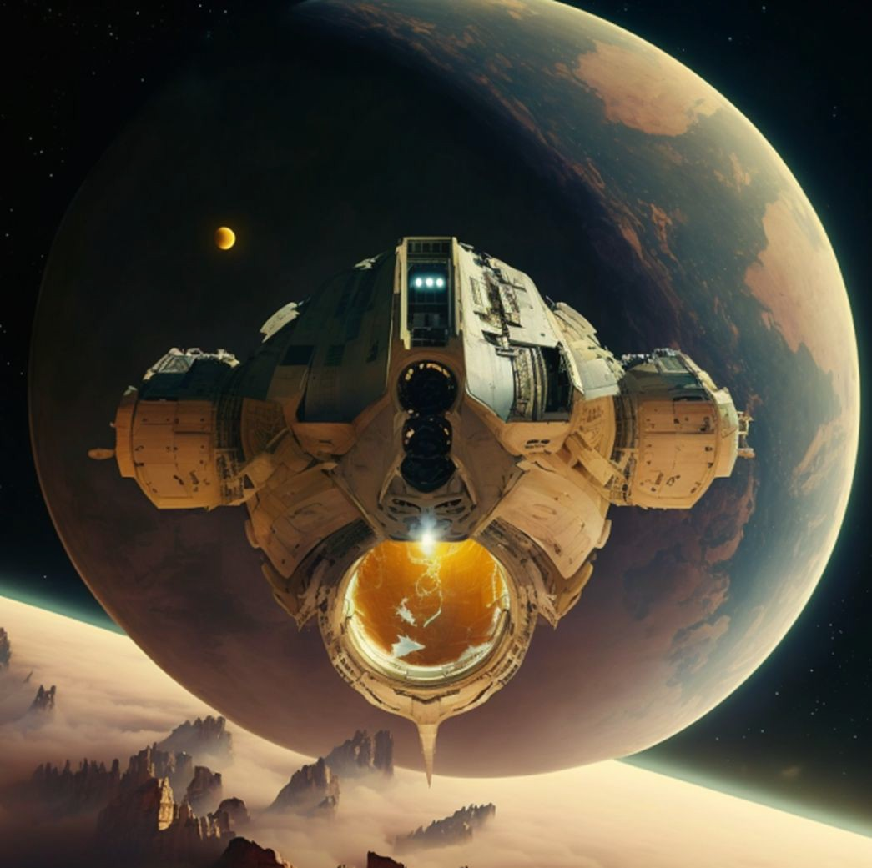
When the ship is loaded and is 100% ready for take oﬀ, you are greeted with a cutscene, showing the moon base you called home shrinking as you head towards a doomed Earth.

Slide 13
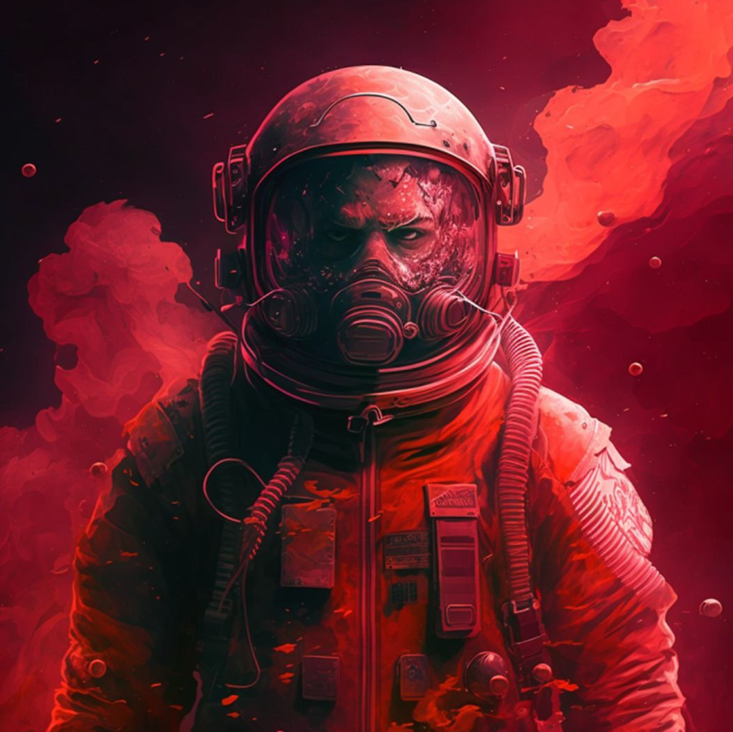
As you look out the window and start to feel safe, you notice your reﬂection. You don’t recognise yourself and as you begin to focus more on the being staring back at you, you begin to realise.
YOU ARE THE INFECTED.

Slide 14

Player Death
In the event the player dies, the Hivemind will possess another poor soul, whom the player will now play as. They begin in another branch of the moon-base.
The player is not explicitly told that every time they die, the play-through does not change, but there will be clues within the game progression to insinuate that this is the case.
Player Death Sound Eﬀect

Slide 15
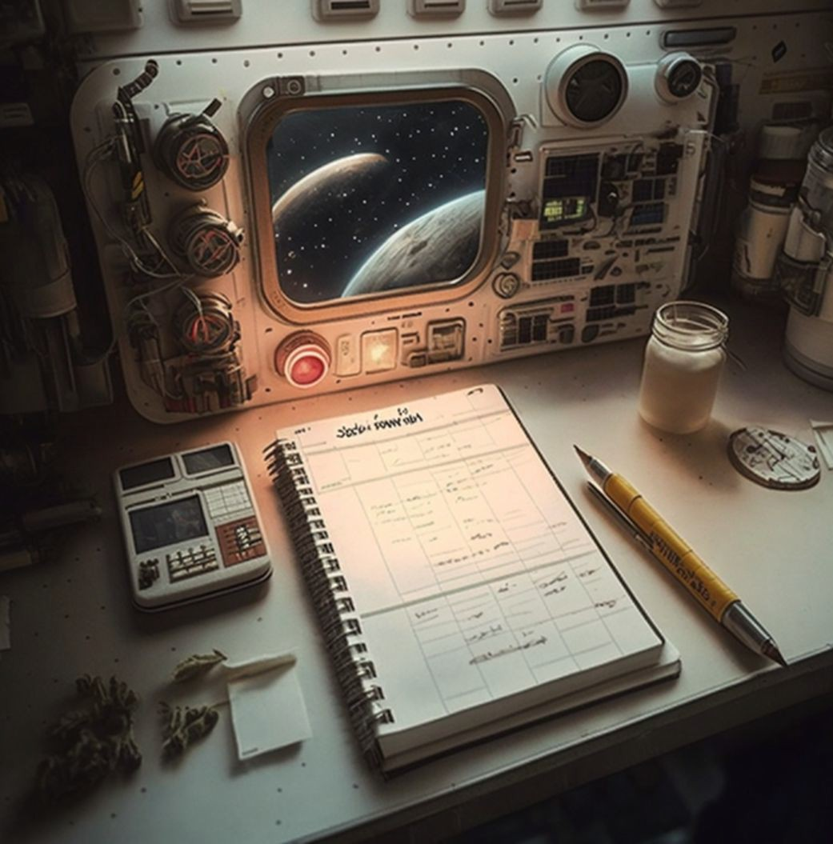
Logs
Scattered throughout the game
Main story
Side stories
Character progression

Slide 16
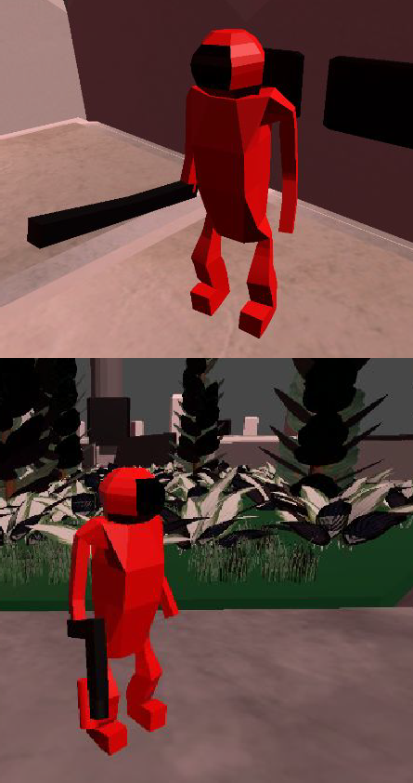
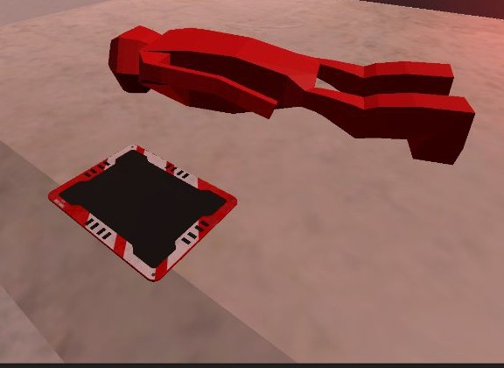
Mechanics (In demo level)
Melee Combat
Story Logs
Gun Combat

Slide 17
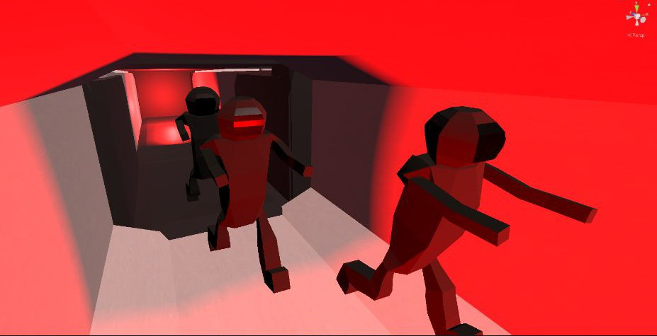
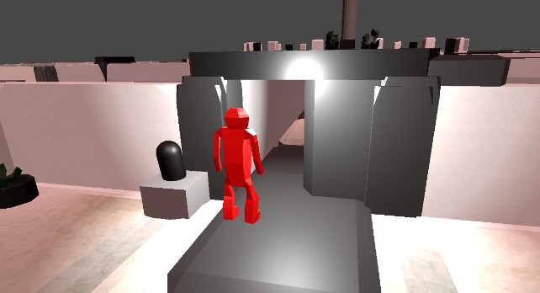
Mechanics
Basic Zombie AI
-Patrol -Chase
Interaction with items and the world
-Doors
-Charging Stations
-Energy Cells

Slide 18
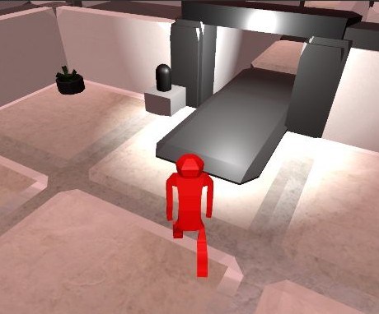
Mechanics
Movement
Sprint Stamina

Slide 19

Art style
Over the shoulder/top down view
Low poly
Concept art made using MidJourney

Slide 20
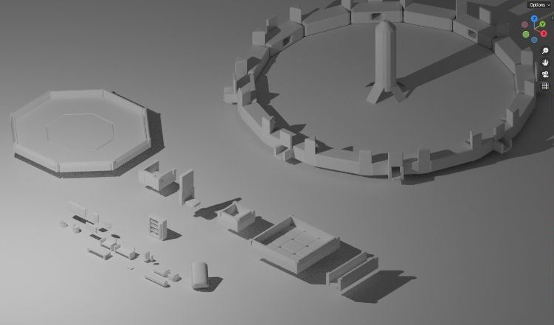
Assets

Slide 21
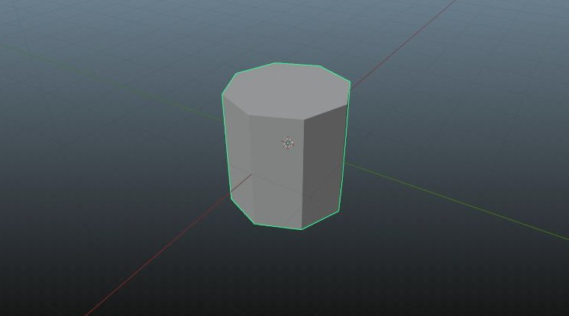
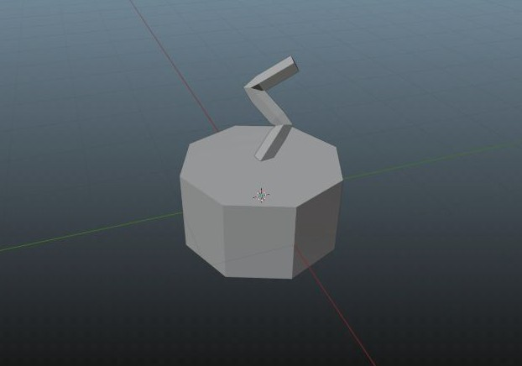
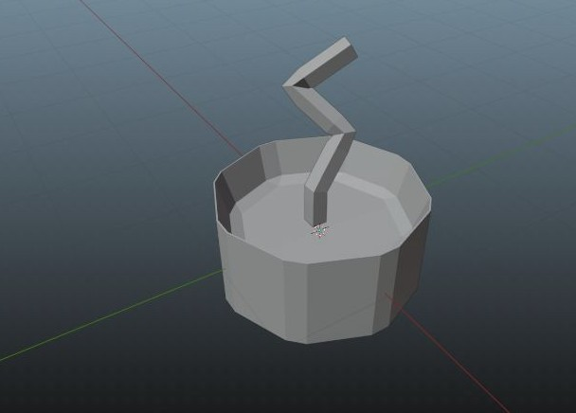
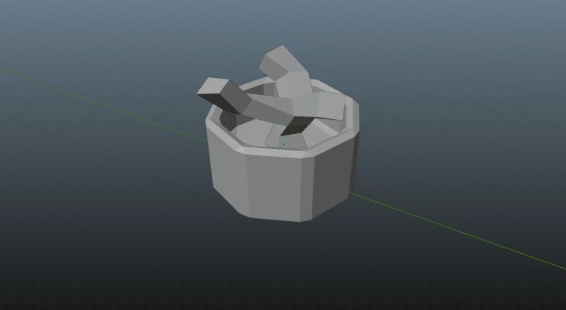

Slide 22
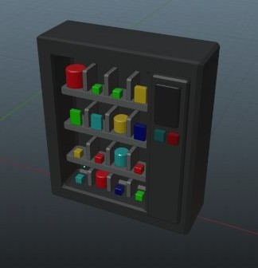
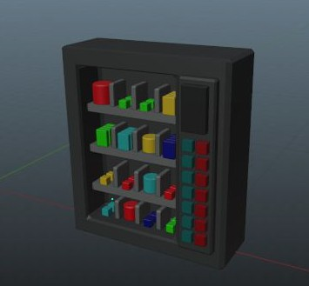
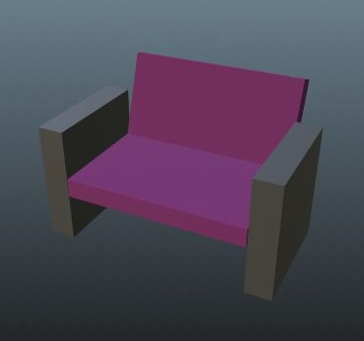
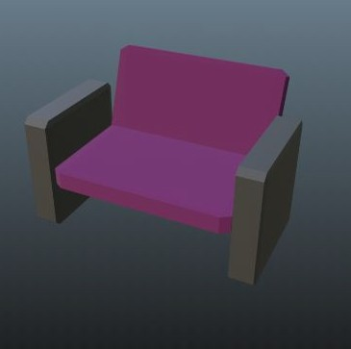

Slide 23
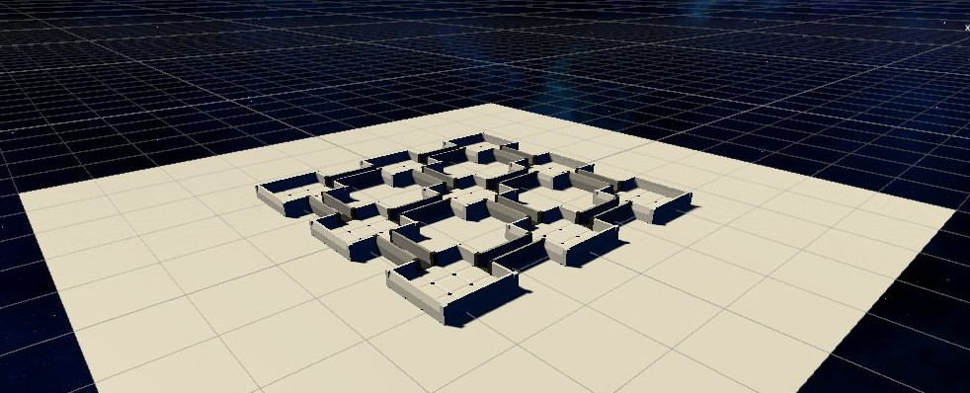
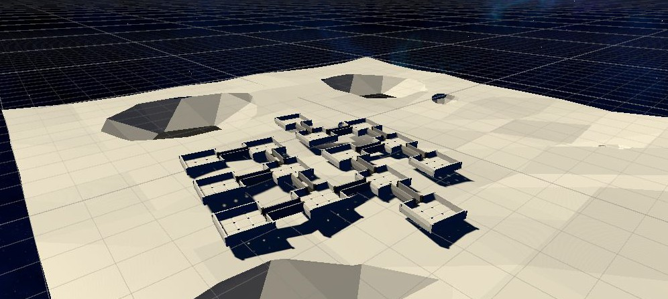

Slide 24
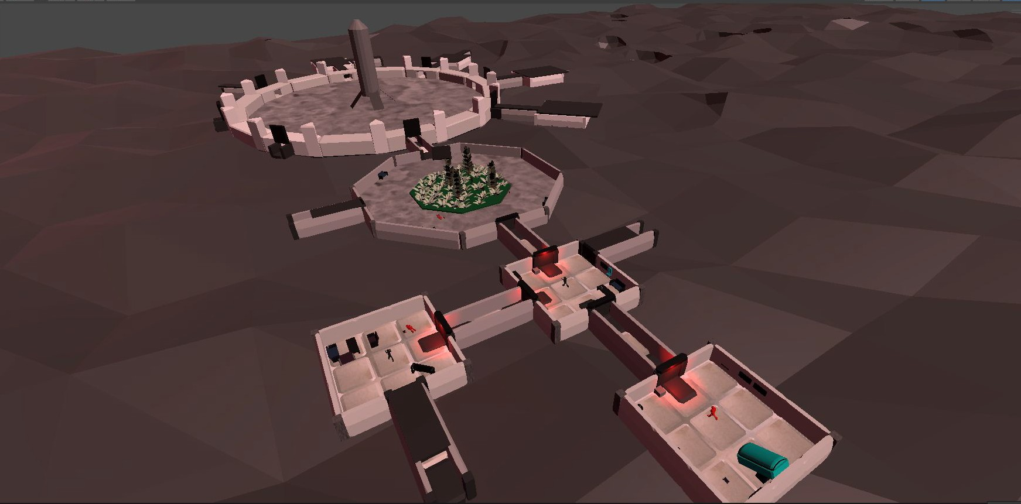
Final moon base picture

Slide 25


Sound Design
Mostly used software such as Audacity and Logic Pro.
Sourced most of the raw sounds through microphone recordings of everyday objects

Slide 26
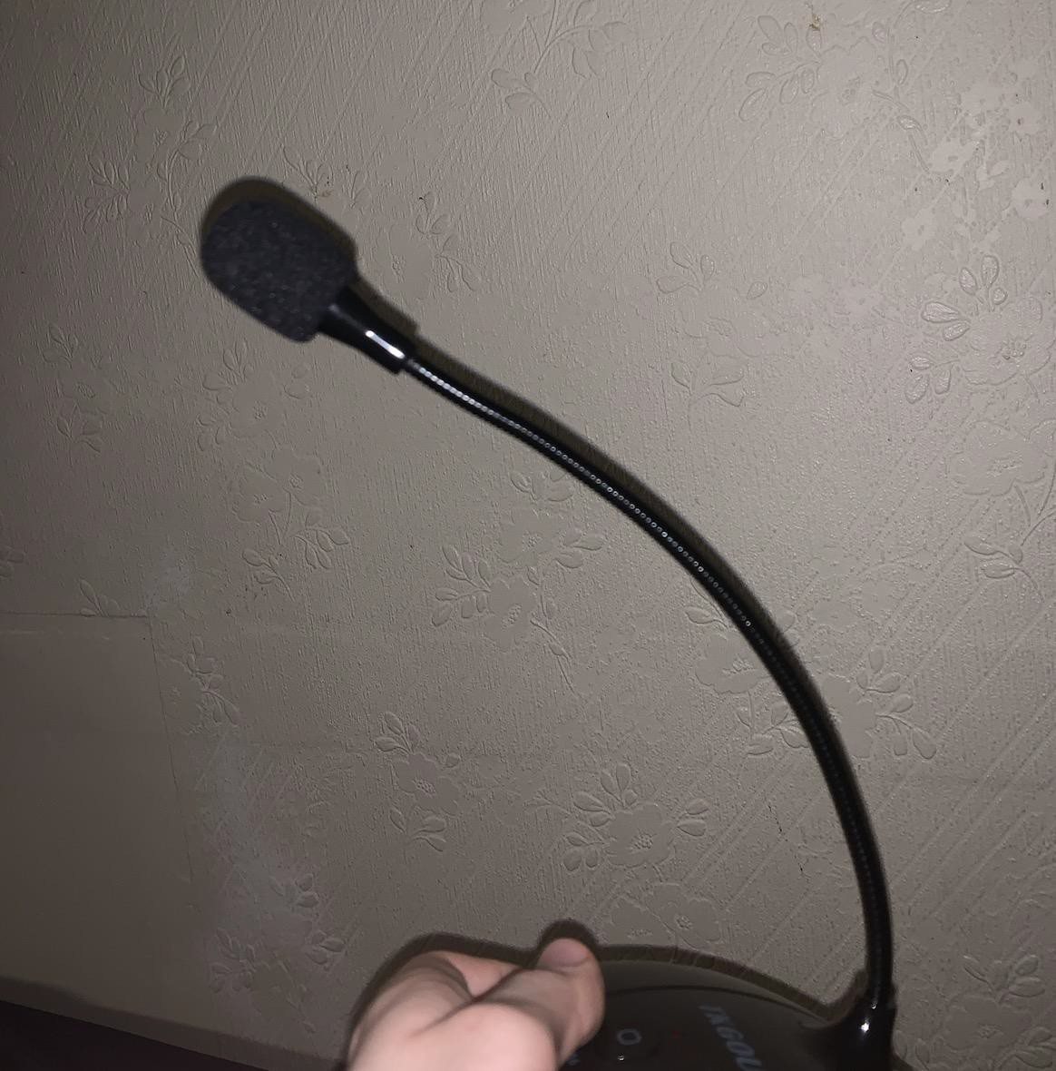
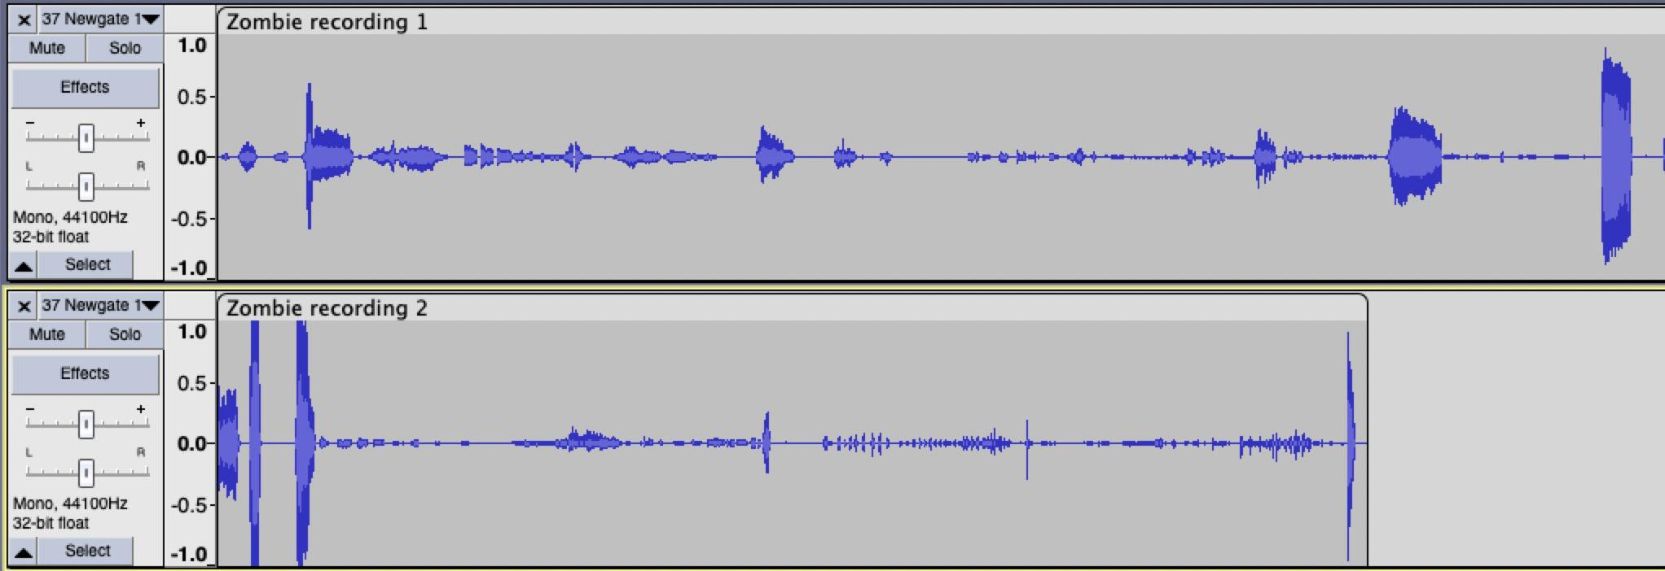
Sound Design Creative Process
1. Record raw audio
2. Isolate and combine audio
Raw metallic sounds

Slide 27
Sound Design Creative Process
3) Apply eﬀects:
Pitch
Tempo
Reverb
Zombie sound eﬀect
Raw audio
End result

Slide 28
Comparisons of Raw Audio and Finalised Sound Effects
Car Boot Open + Microwave + Air Freshener
=
Moon Base Door
File on Wood + File on Metal + Oven Turn On
=
Large Cargo Bay Door
+ Frying Pan
+ Hob Overhead Fan

Slide 29
Music
Lunar Mortis has 7 musical themes:
Main Theme
Dead Moon
Plague of Titan
A Plea into Darkness
Saturnine Requiem
Dead Moon (Extended)
Echoes in the Dark
Full Soundtrack can be found on YouTube

Slide 30
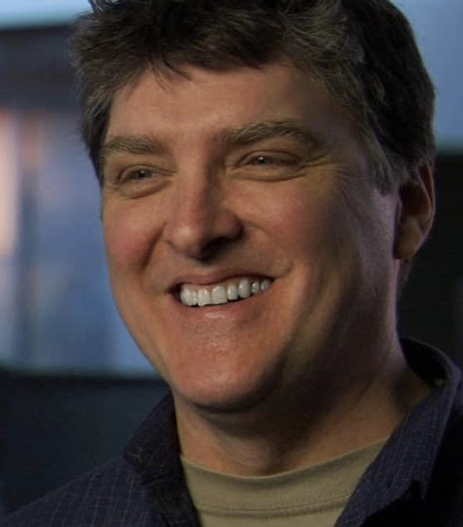

Music - Inspiration
Martin O’Donnell
Composer and Sound Designer for the Halo game series
Johan Söderqvist
Composer for Battleﬁeld 1 and Battleﬁeld V

Slide 31
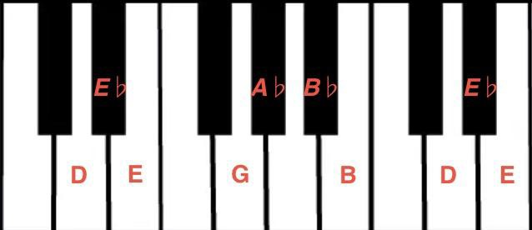
Music - Style
Most of the music written in a variant of the E♭ Phrygian scale

Slide 32
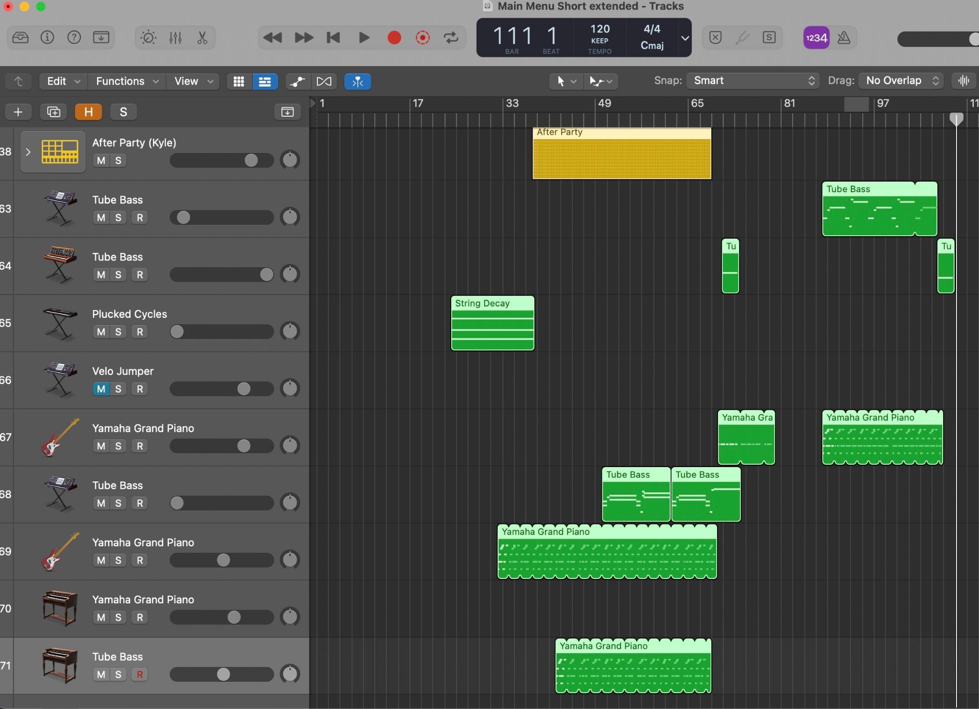
Music Composition Creative Process
Experiment with chords and melodies on the piano
Record any chords or melodies that sound captivating or ﬁtting
Iteratively add more sounds and music over the base chord progression of melody to progressively lengthen and enrich it
Adjust harmonics, reverb and equaliser to achieve the desired level of space and as well as ensuring the ﬁnal piece has good sound quality

Slide 33



Business plan
Target audience
Steam users
Age rating of 16+
Rogue-like
Space
Horror
Story telling

Slide 34
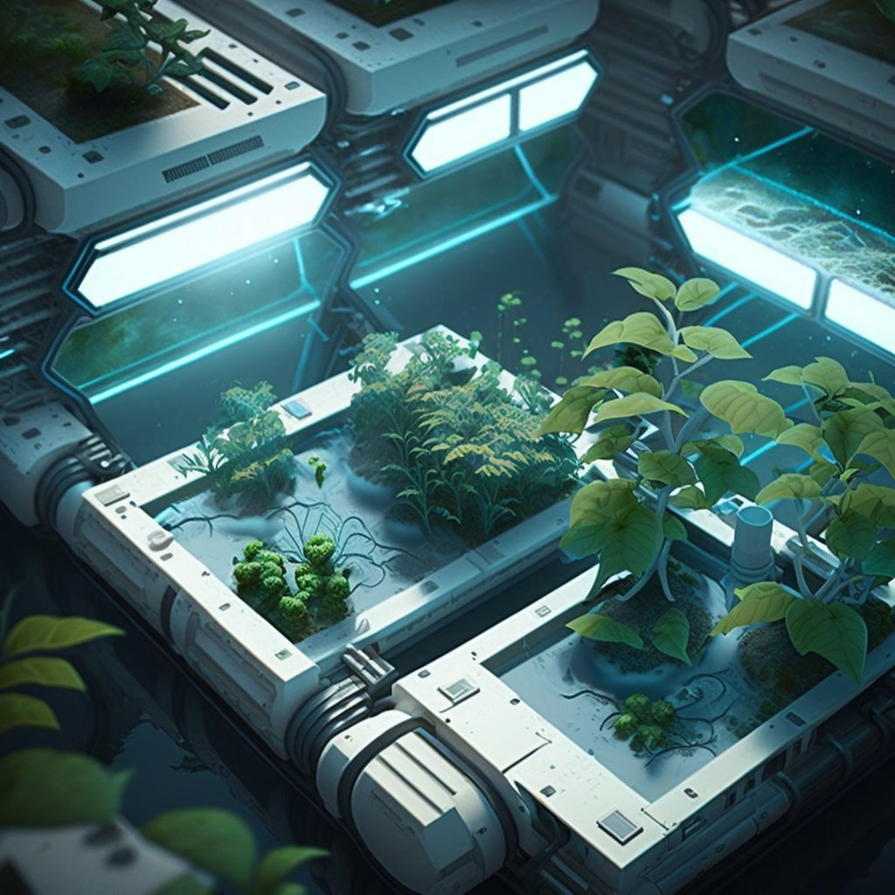
Price
£10 full price
£5 expansions
£0.99 in-game cosmetics

Slide 35
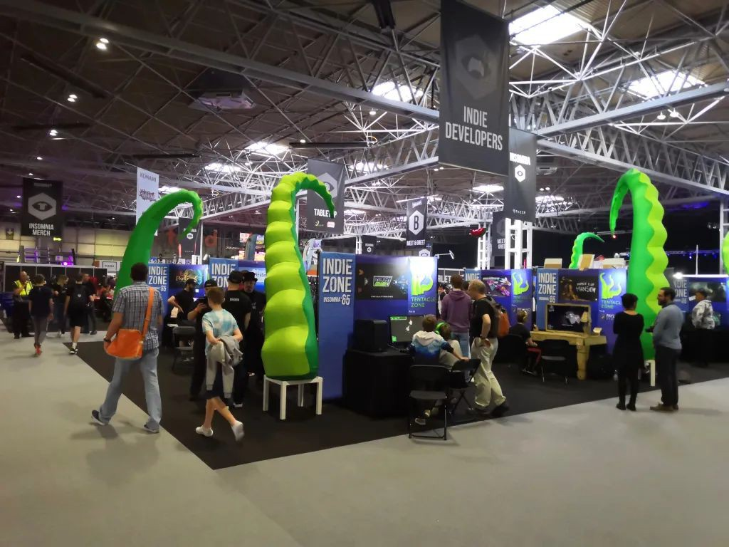






Advertising
Kickstarter
Streaming platforms (Twitch, YouTube Gaming, Facebook Gaming)
Gaming forums (Reddit)
Social media (YouTube, TikTok, Twitter)
Gaming events (Insomnia 65)
Word of mouth

Slide 36
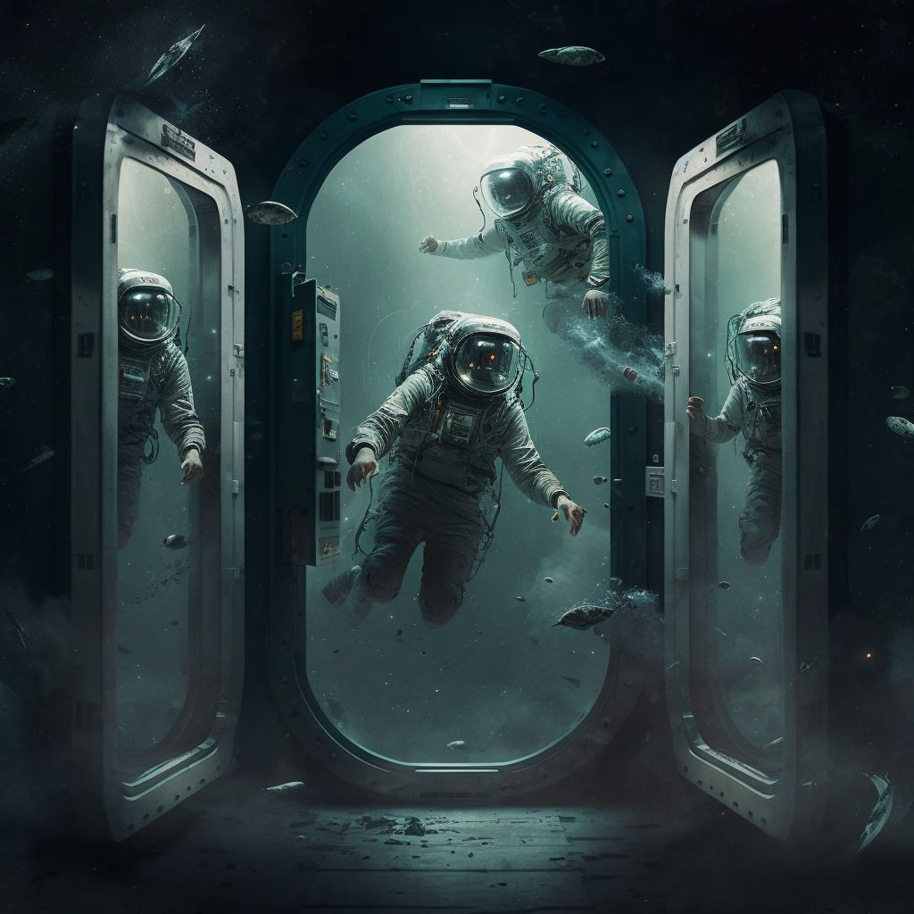

Platform
Full release on Steam
Possibility for Xbox Game Pass

Slide 37

Maintaining the game
Communicating with our audience
Staying on top of bug reports
Saving 20% of net profit for expansions
Adding new content
Offering a sale

Slide 38
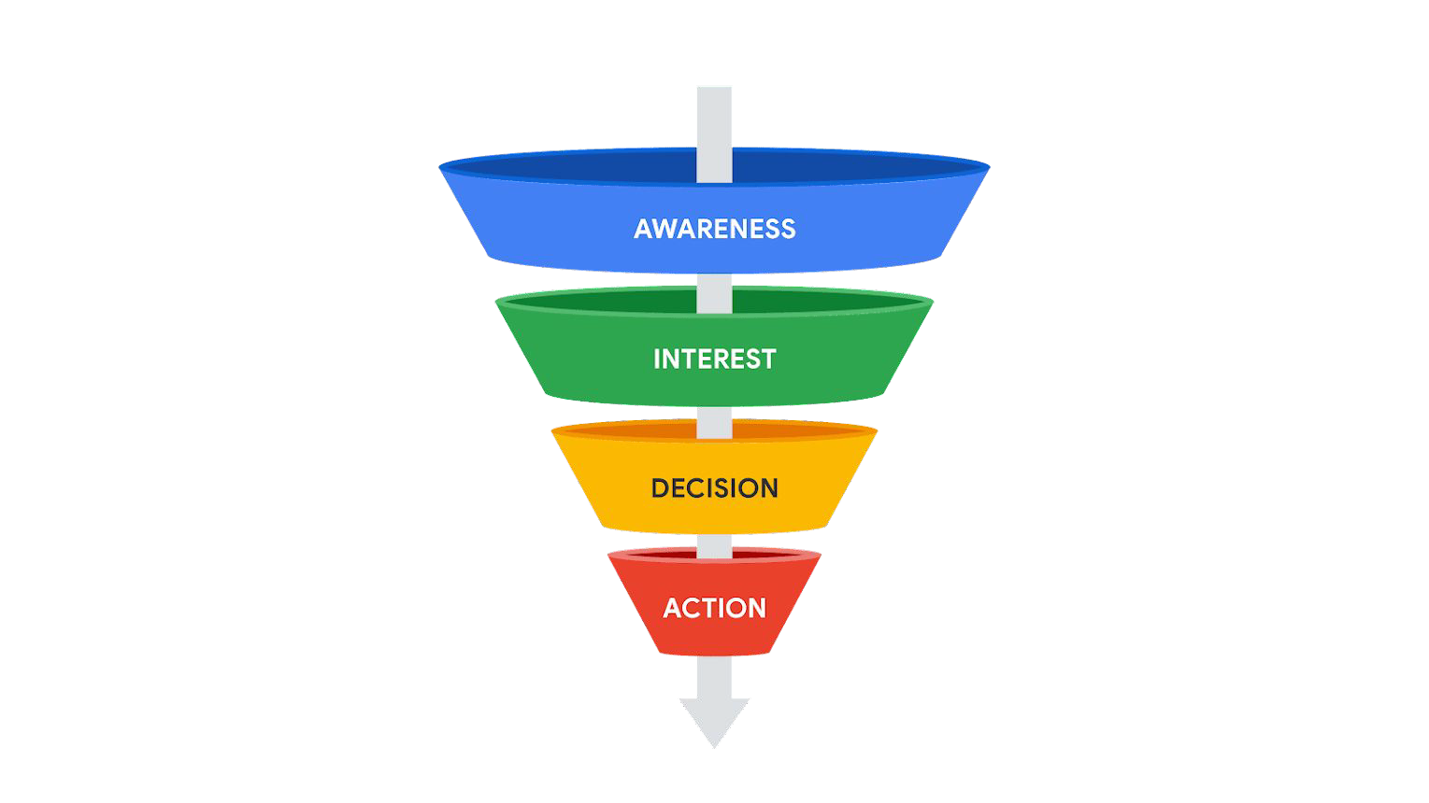
The perfect storm
Initial sales
51,428 X 10 = £514,280
120 million
Gross profit Steam tax
0.30 x 514,280 = £154,284
17,142,857
£514,280 - £154,284 = £359,996
1,714,285
Tax
0.80 x £359,996 = £287,996.8
51,428
Unity Plus
£350 x 5 = £1,750
£287,996.8 - £1,750 = £286,246.8
Net profit
£286,246.8 (No royalties paid)

Slide 39
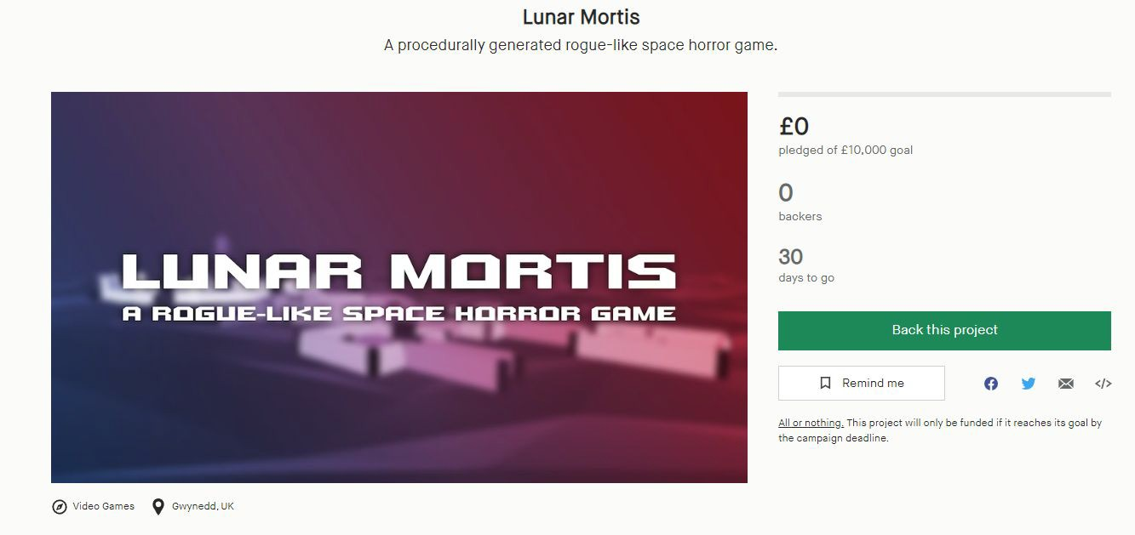
Kickstarter

Slide 40

Initial income
Kickstarter - £10,000
B-Enterprising grant - £1,500
Self investment - £3,500
Total: £15,000

Slide 41
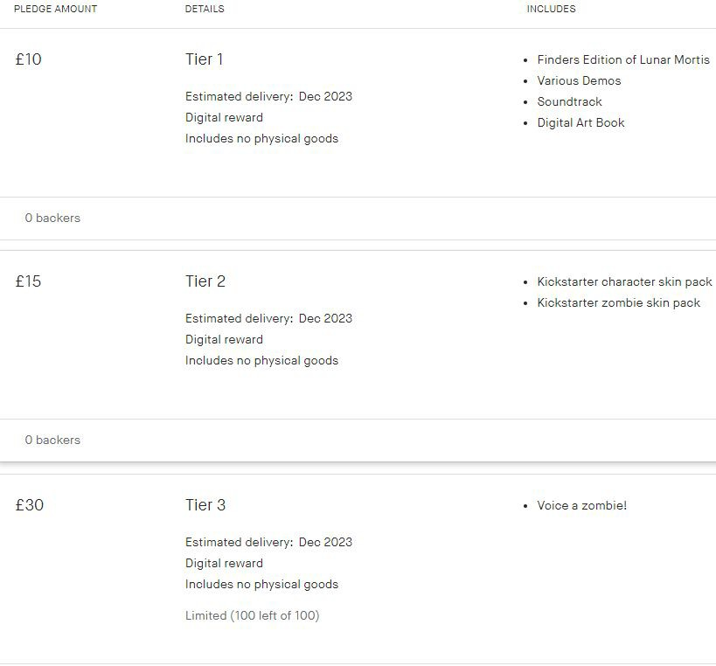
Kickstarter donation tiers

Slide 42
Budget Breakdown
Development costs (£6,000)
This includes the cost of software licenses, hardware, and other development tools that the team will need to create the game. Some of the key expenses in this category include:
Game engine licenses: We will be using the Unity Personal Licence for development. In doing this we do not need to pay for a licence until the game exceeds $100,000 in sales or funding.
Development hardware: Certain team members will need a powerful computer capable of running the game engine and other development software. The cost of these computers can range from £1,500 to £3,000 each.
Development software: In addition to the game engine, we will need software tools such as 3D modeling software, programming editors, and audio editing tools. These can cost several hundred to several thousand pounds per license.

Slide 43
Art and animation (£5,000)
This includes the cost of creating the game's visual assets, including character models, level designs, and animations. Some of the key expenses in this category include:
Concept art: We will need to hire a concept artist to create initial sketches and designs for the game's characters and environments. This can cost several hundred pounds, depending on the artist's experience and skill level.
Animation: We will also need to hire an animator to create animations for the characters and objects in the game. This can cost several hundred to several thousand pounds, depending on the complexity of the animations and the animator's experience.

Slide 44
Kickstarter fees and taxes (£1,500)
This includes the fees charged by Kickstarter for hosting the campaign, as well as any taxes or other fees associated with receiving the funding.

Slide 45
Miscellaneous expenses (£2,500)
This includes any other expenses that may arise during the development process, such as legal fees, office expenses, or travel expenses for attending conventions or events.
By breaking down the budget into these categories, we can ensure that we have adequate funding to cover all aspects of the development process and create a high-quality game that will be enjoyable for players.

Slide 46
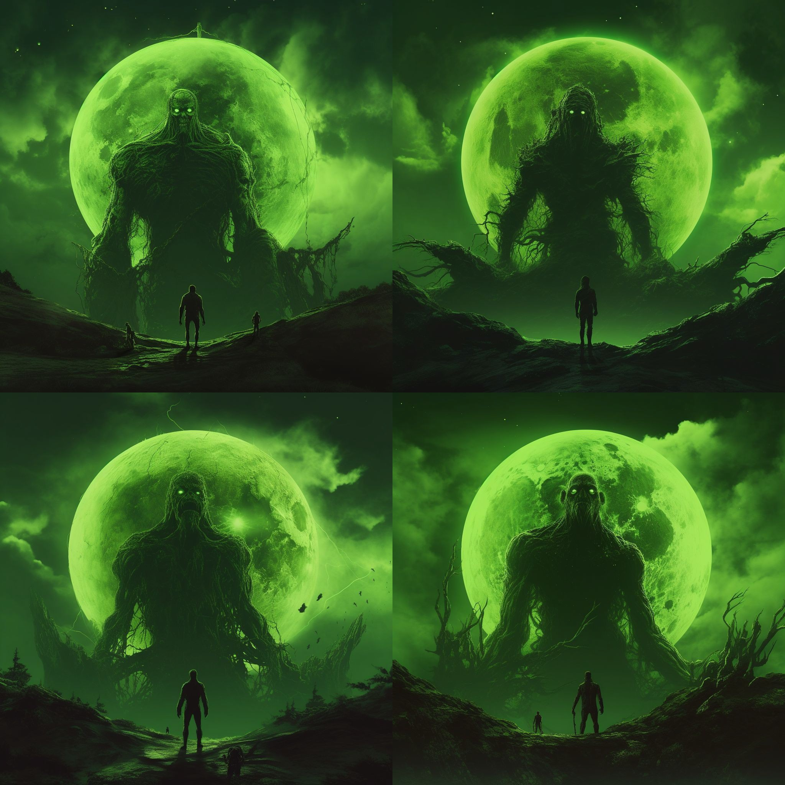
Stretch Goals
If we exceed our Kickstarter funding target of £10,000, we intend to utilise the extra funds to push additional content into the game at the following stretch target goals:
£12,000: Free-play zombie murder party
£15,000: Zoonar Mortis expansion
£20,000: The Depth of Mortis expansion

Slide 47
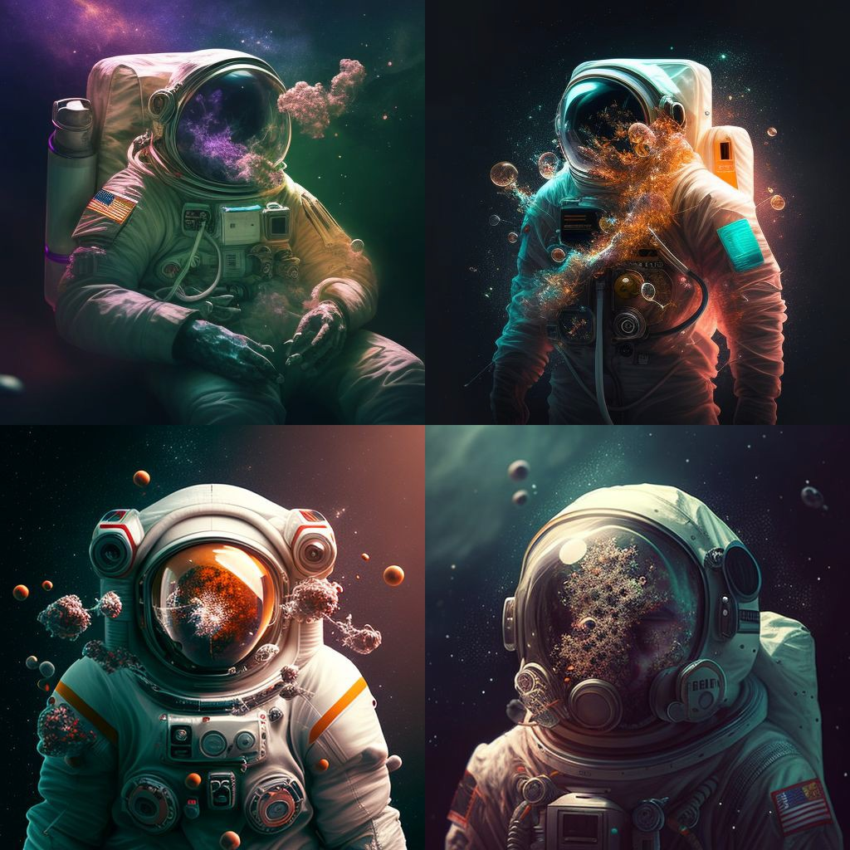
Risks and Challenges
Inexperience of the team members.
To mitigate this risk, the team can seek guidance and mentorship from experienced game developers. They can also take online courses and attend workshops to enhance their skills. Another option is to bring in experienced professionals to the team to help guide and mentor the less experienced team members.

Slide 48
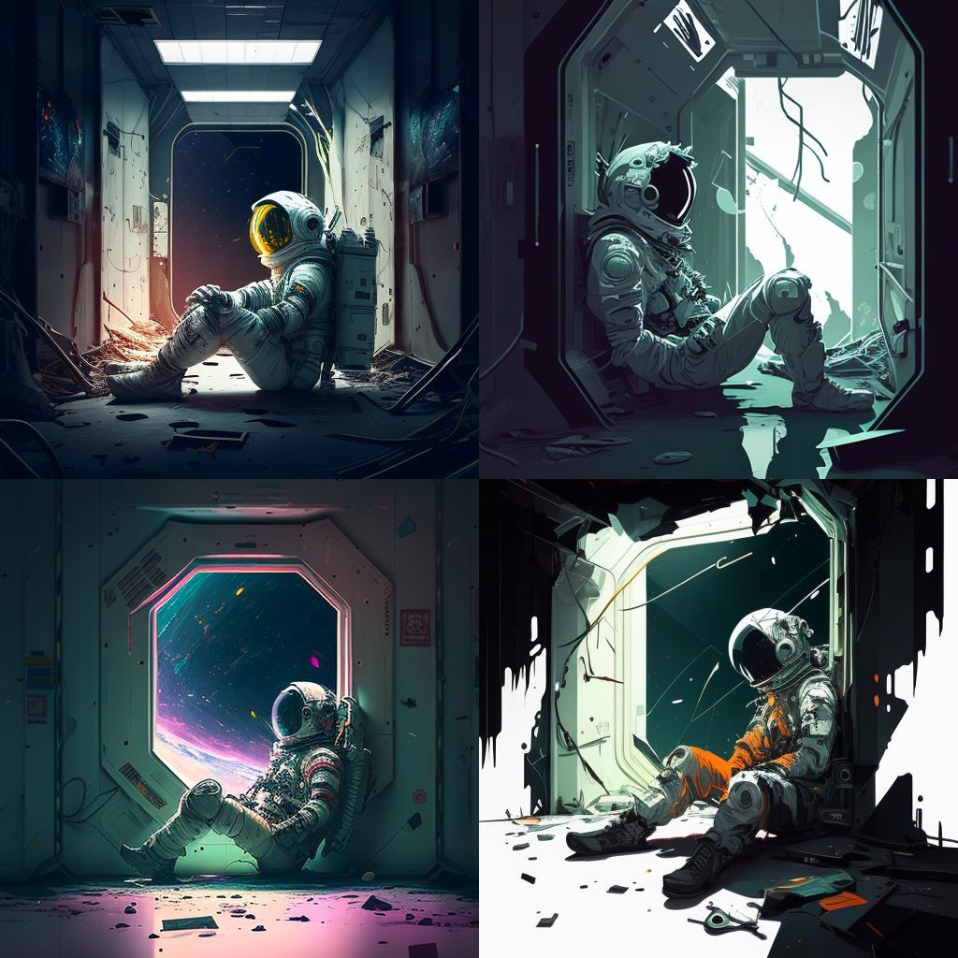
Risk: Delays in development.
To prevent delays, the we have set a realistic timeline for the development process and monitor progress regularly. We have also broken down the development process into smaller milestones to help keep the project on track. Additionally, we will prioritize the most critical features of the game and work on them first to ensure that they are completed on time.

Slide 49
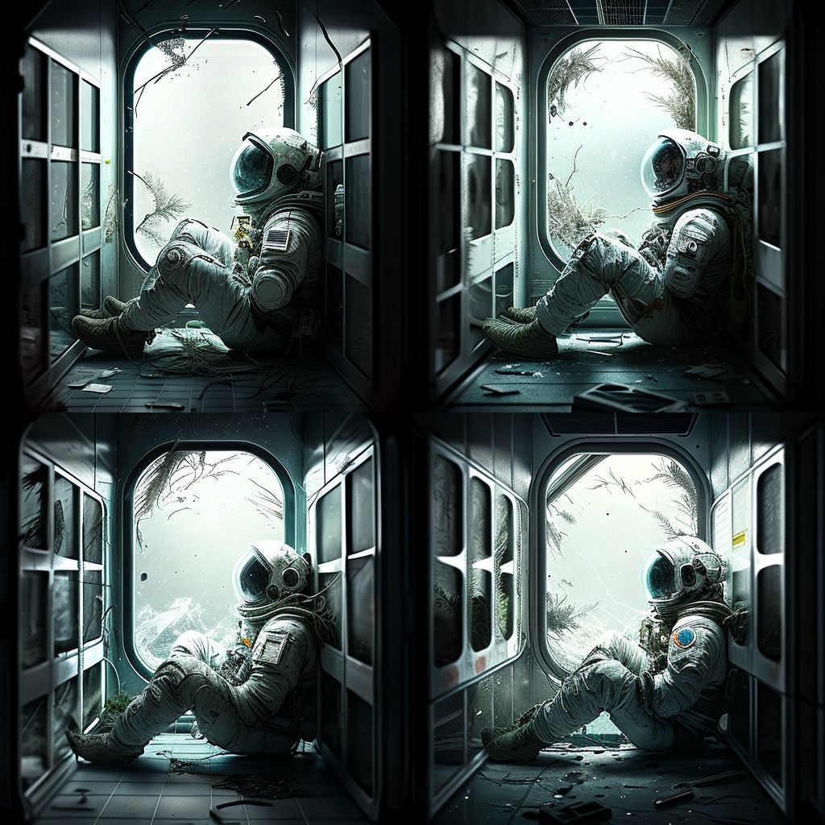
Risk: Difficulty in meeting the game's technical requirements.
We can identify the technical requirements early in the development process and allocate resources and time to ensure that they are met. We can also seek advice and support from other developers and online communities to help overcome any technical challenges.

Slide 50
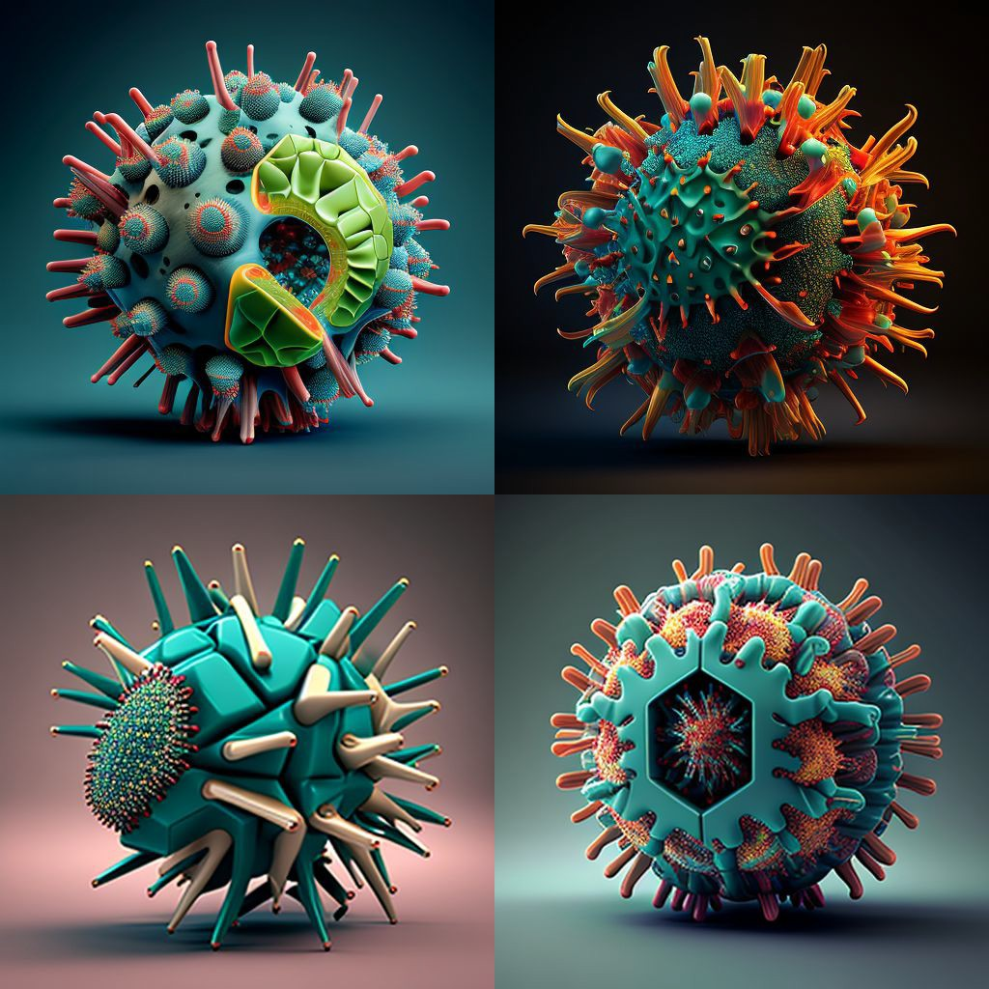
Risk: Failure to meet the Kickstarter goal.
We can mitigate this risk by carefully planning and executing our marketing strategy to reach a wider audience.

Slide 51
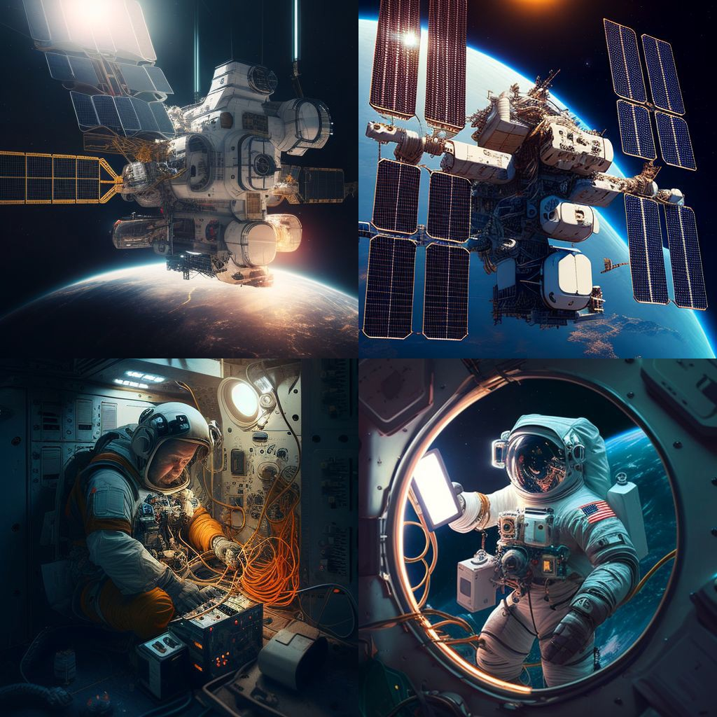
Risk: Limited resources for development.
We will manage our resources effectively by prioritizing the most critical features of the game and focusing on completing them first. We will also consider outsourcing some aspects of the development process, such as art and animation, to reduce our workload and ensure that we meet our deadlines.
Additionally, we can explore alternative funding sources such as grants or angel investors to help cover the development costs.

Slide 52
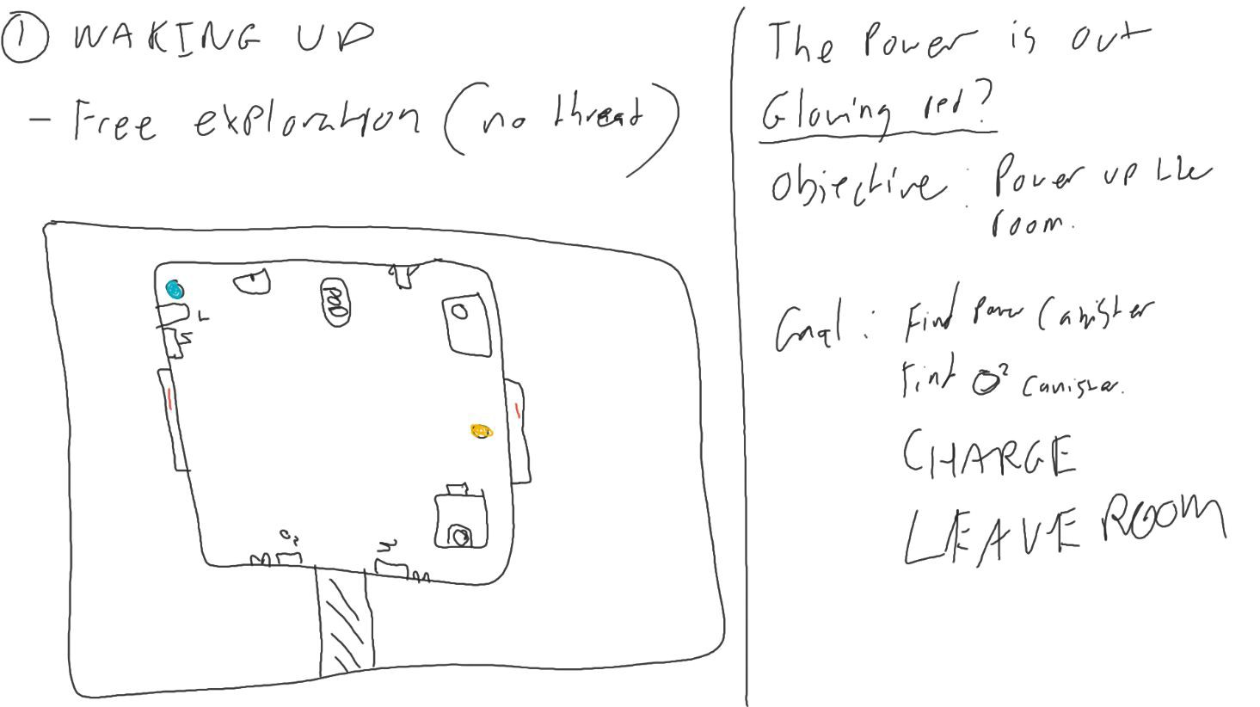
Initial level design

Slide 53
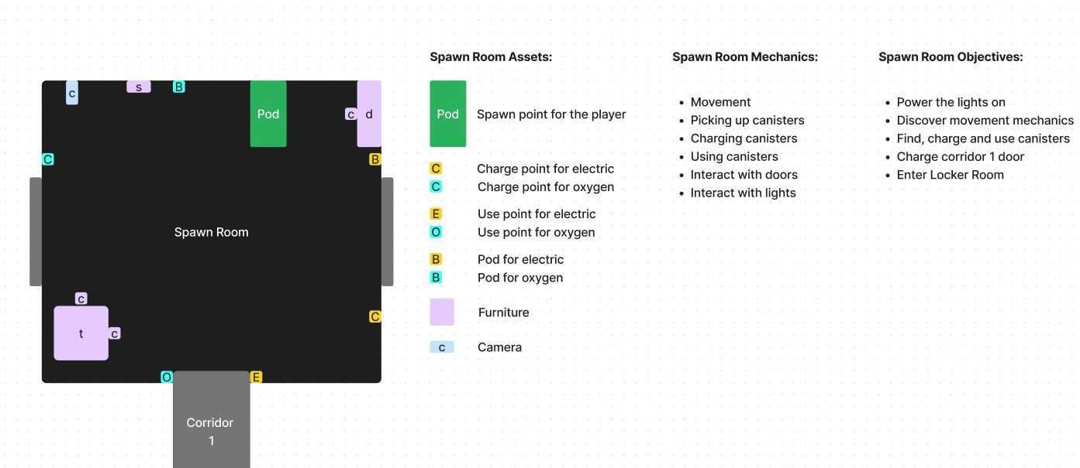
Figma board - Demo level design

Slide 54
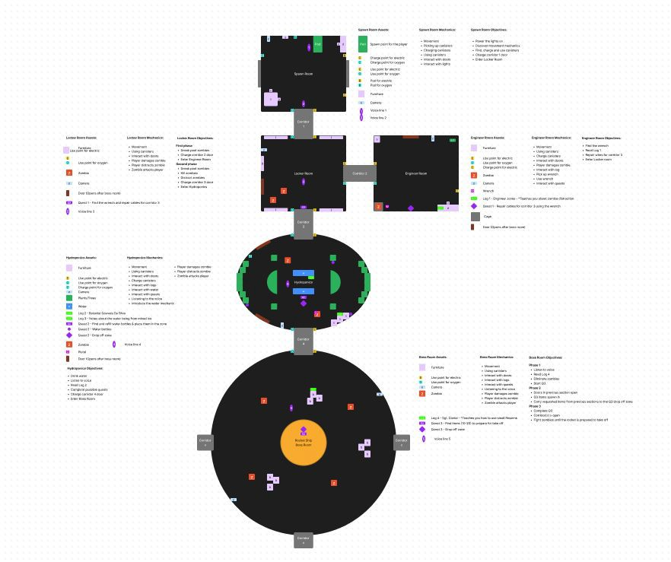
Figma board - Demo level design

Slide 55
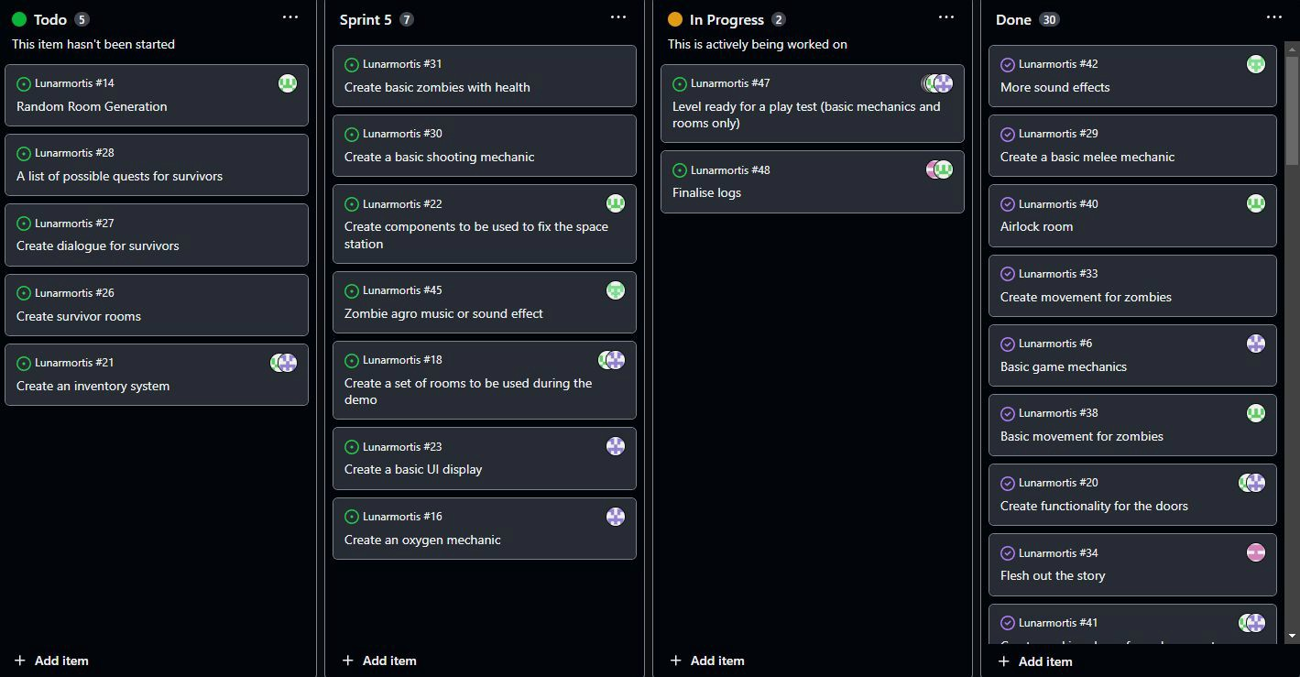
Github kanban

Slide 56

Future Mechanics
Implement Base Mechanics
Damage to station/repairing mechanics
Survivors
Quests/bonus objectives

Slide 57
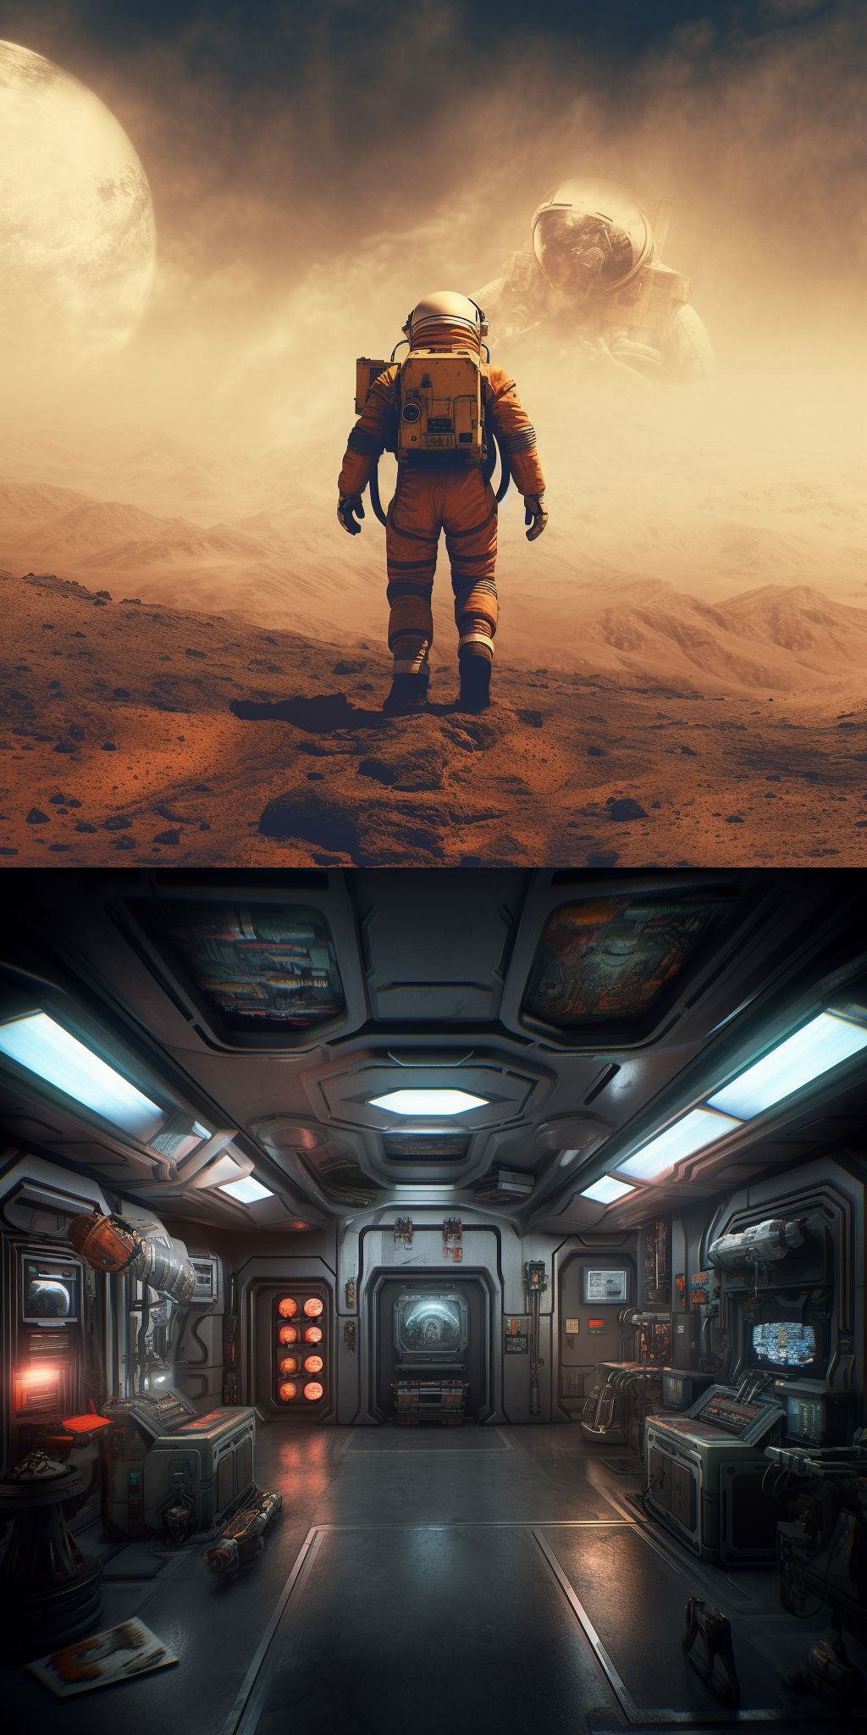
Future Mechanics
Implement Base Mechanics
Moonwalking
Fog of War
Room Types

Slide 58
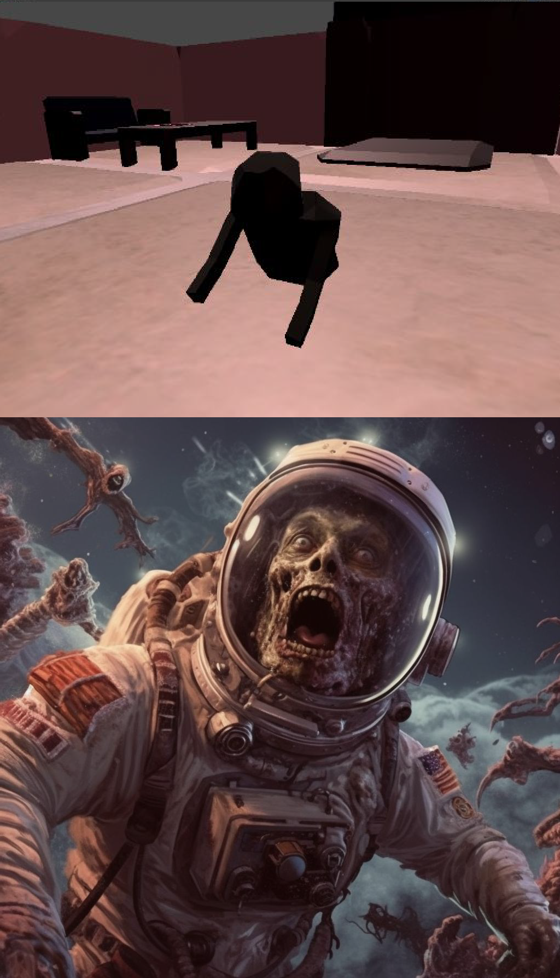
Future Mechanics
Reworked Zombie Mechanics
Thorough zombie movement and detections
Zombie Variation and limb damage
Bosses

Slide 59
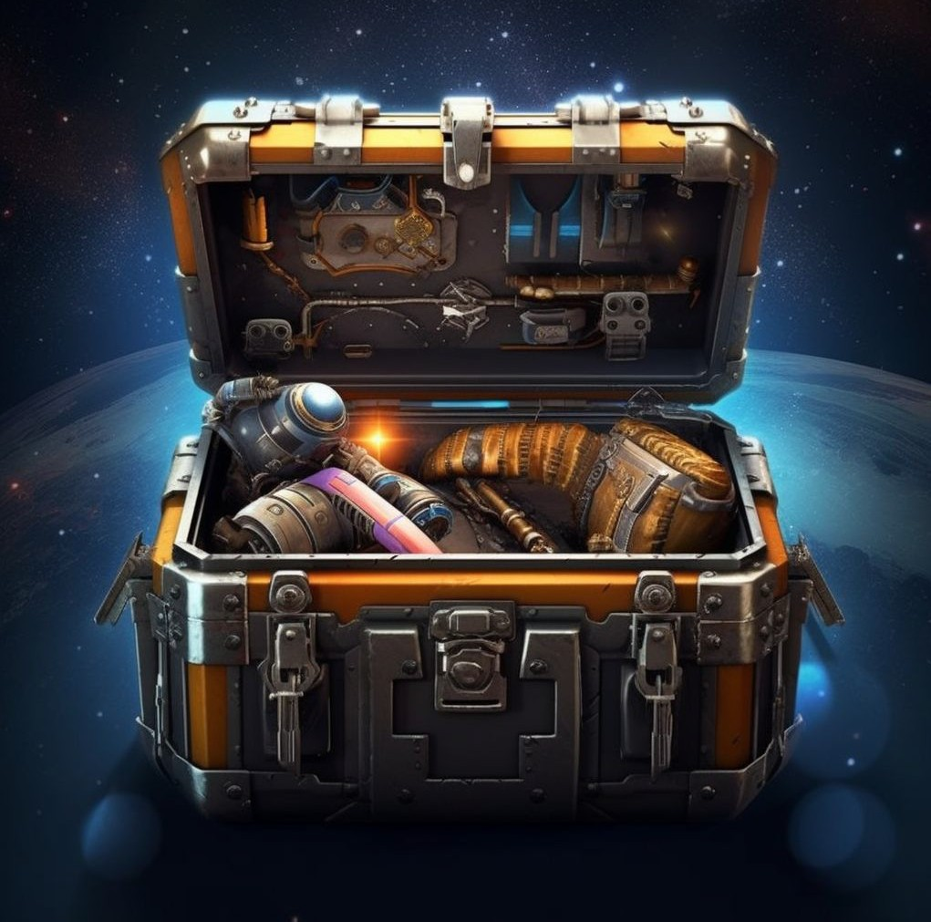
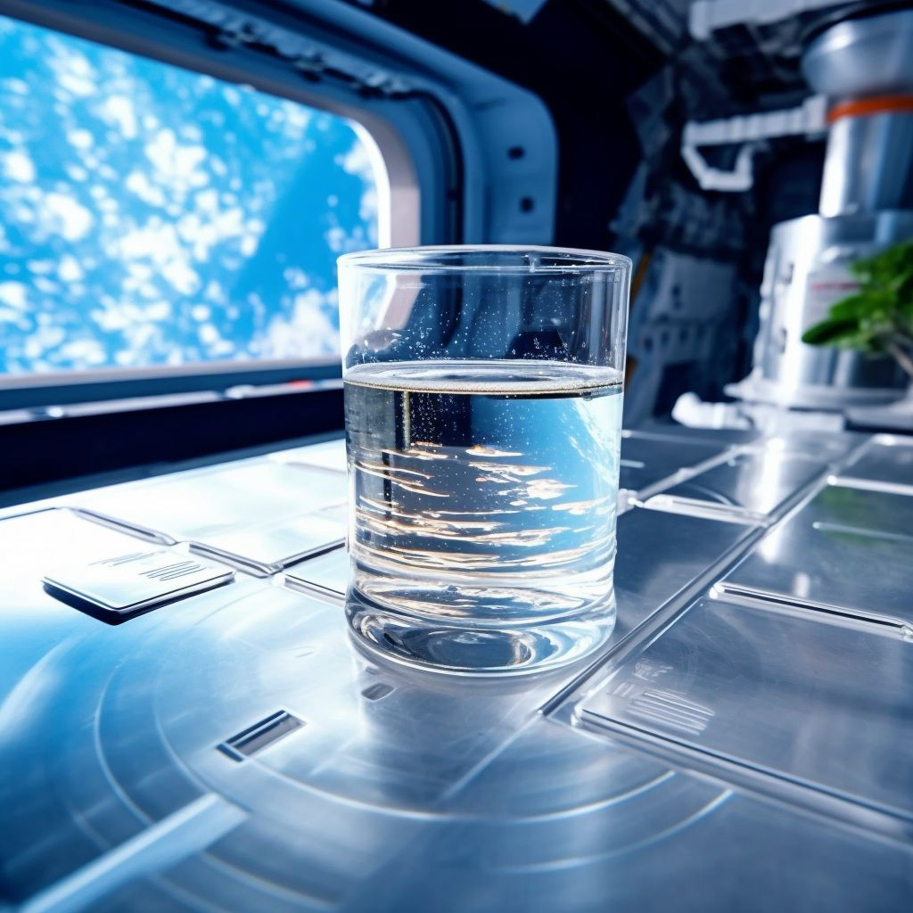
Future Mechanics
Oxygen/water mechanic
Loot
Procedural Generation

Slide 60
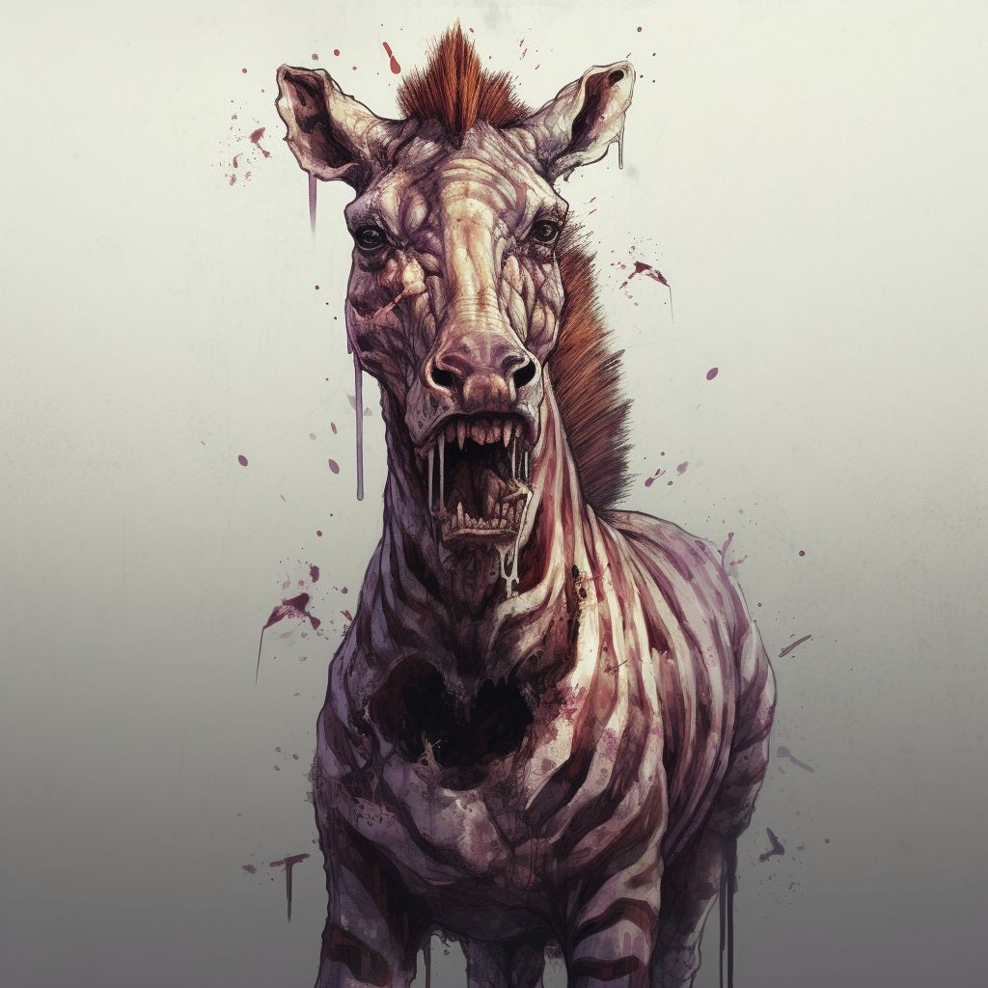

- New rooms
Future additions
Immense potential for DLC
New Enemies
New Loot
New Story
Zoonar Mortis
The Depth of Mortis

Slide 61
Special thanks
James Elton
Hivemind voice Fabienne Clarke Zombie voices Pete Butcher
Guidance, logos, emotional support

Slide 62







Pier Bouchère

